Slide 1
Chapter 3 Container Orchestration with Kubernetes

Slide 2
Learning Topics
Overview of Kubernetes
Kubernetes Architecture
Kubernetes Installation – Bare Metal
Key Components
Deploy Dockerized Apps
Horizontal Pod AutoScaler

Slide 3
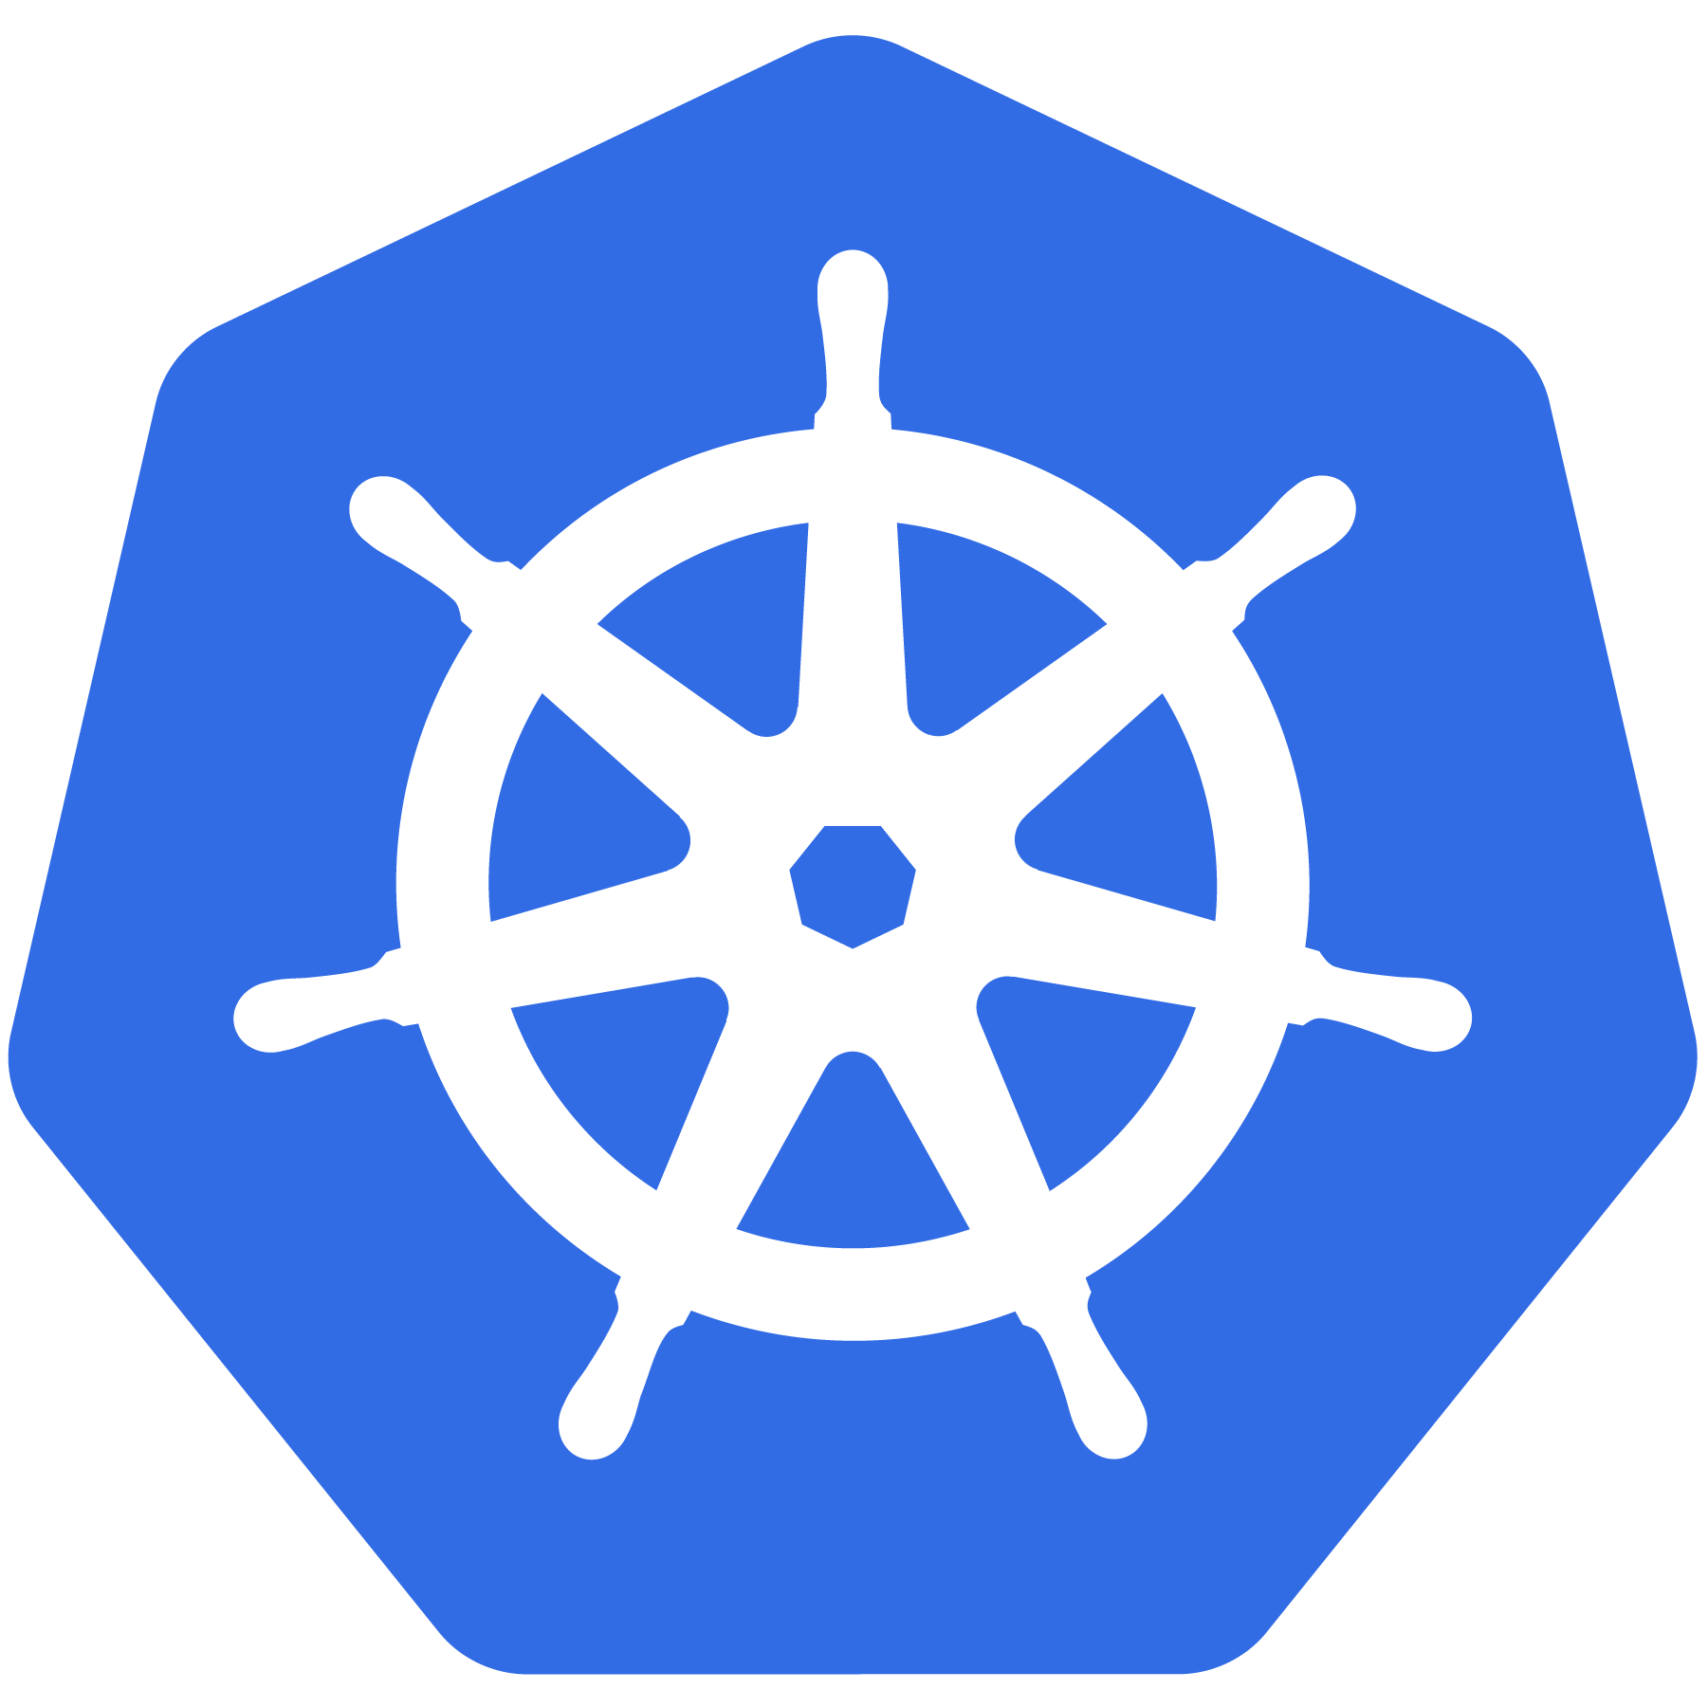
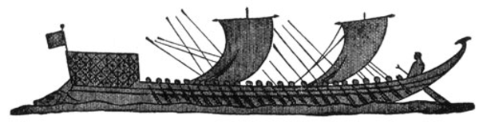
Kubernetes Meaning
Greek for “pilot” or
“Helmsman of a ship”

Slide 4
K8s History
Project that was spun out of Google as an open source container orchestration platform.
Built from the lessons learned in the experiences of developing and running Google’s Borg and Omega.
Designed from the ground-up as a loosely coupled collection of components centered around deploying, maintaining and scaling workloads.

Slide 5
K8s History
Contributors include Google, CodeOS, Redhat, Mesosphere, Microsoft, HP, IBM, VMWare, Pivotal, SaltStack etc.
Kubernetes is loosely coupled, meaning that all the components have little knowledge of each other and function independently.
This makes them easy to replace and integrate with a wide variety of systems
Written in Go Language

Slide 6

Who Manages Kubernetes
Sub-Foundation of Linux Foundation
A Vendor Neutral Entity to Manage “Cloud Native” Projects
Focused on
Containers
Dynamic Orchestration
Many More Services

Slide 7
Issues with Containers
Scheduling – Where Should my Containers Run?
Lifecycle & Health - Keep my Containers Running Despite Failures
Discovery – Where are my Containers Now?
Monitoring – What’s Happening with my Containers Now?
Authorization – Control Who Can do Things to my Containers
Scaling – Make Jobs Bigger or Smaller

Slide 8
What Does Kubernetes Do?
Groups containers that make up an application into logical units for easy management and discovery
It acts as an engine for resolving state by converging actual and the desired state of the system
It is declarative, you tell it what you want it to be, and it figures it out
e.g. ‘I want 3 instances of x’ and it just does it, if something dies, it brings it back to get to 3

Slide 9
Most Popular Use Cases
Autoscale Workloads
Blue/Green Deployments
Scheduled Cronjobs
Manage Stateless Applications
Easily Integrate and Support 3rd Party Apps
Provide Native Methods of Service Discovery

Slide 10
Kubernetes Features
Kubernetes is an open-source system for
Automating Deployment
Scaling
Management
of containerized applications
Kubernetes can scale without increasing your ops team

Slide 11
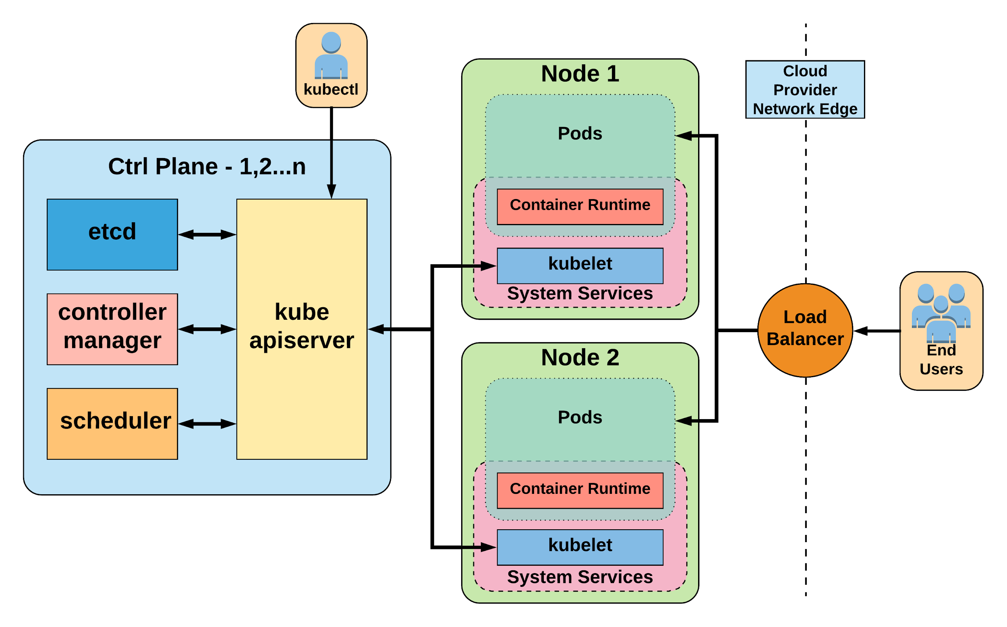
Kubernetes Architecture

Slide 12
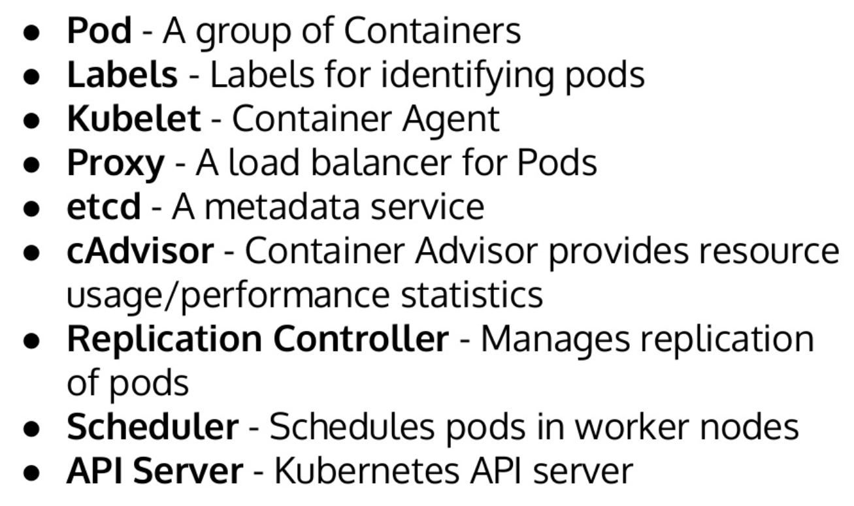
Key Terminologies

Slide 13
Control Plane Components
Kube-apiserver
Gate keeper for everything in kubernetes
EVERYTHING interacts with kubernetes through the apiserver
Etcd
Distributed storage back end for kubernetes
The apiserver is the only thing that talks to it
Kube-controller-manager
The home of the core controllers
Kube-scheduler
Handles placement

Slide 14
Kube-apiserver
Provides a forward facing REST interface into the kubernetes control plane and datastore.
All clients and other applications interact with kubernetes strictly through the API Server.
Handles authn, authz, request validation, mutation and admission control and serves as a generic front end to the backing datastore

Slide 15
etcd
etcd acts as the cluster datastore.
Purpose in relation to Kubernetes is to provide a strong, consistent, highly durable and highly available key-value store for persisting cluster state.
Stores objects and config information.

Slide 16
Kube-controller-manager
Its the director behind the scenes
Serves as the primary daemon that manages all core component control loops.
Monitors the cluster state via the apiserver and steers the cluster towards the desired state.
Does NOT handle scheduling, just decides what the desired state of the cluster should look like
e.g. receives request for a deployment, produces replicaset, then produces pods

Slide 17
Kube-scheduler
Scheduler decides which nodes should run which pods
Serves as the primary daemon that manages all core component control loops.
Monitors the cluster state via the apiserver and steers the cluster towards the desired state.
Does NOT handle scheduling, just decides what the desired state of the cluster should look like
e.g. receives request for a deployment, produces replicaset, then produces pods

Slide 18
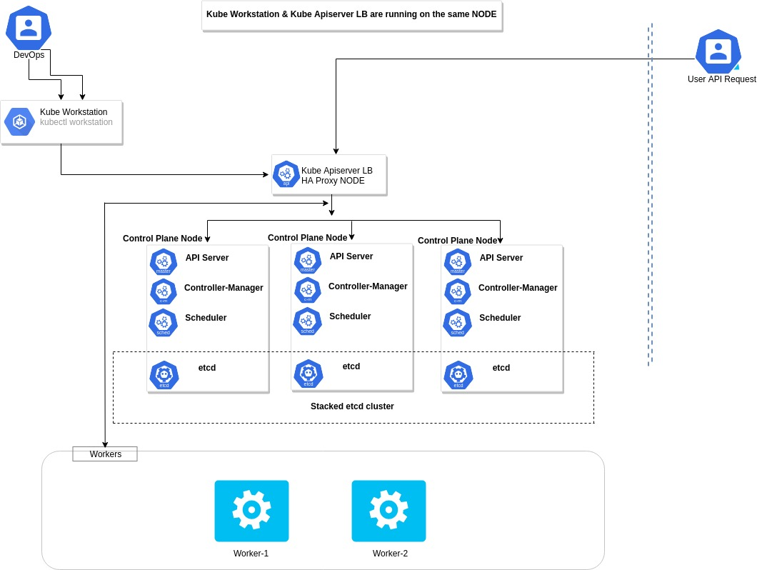
HA Cluster Architecture

Slide 19
Node Components
Kubelet
Agent running on every node, including the control plane
Kube-proxy
The network ‘plumber’ for Kubernetes services
Enables in-cluster load-balancing and service discovery
Container Runtime Engine
The containerizer itself - typically docker

Slide 20
Pods
Smallest Unit of Work
Collection of One or More Containers
Share Volumes, Network Namespace
Part of Single Context, Managed Together
Ephemeral in Nature

Slide 21
Kubelet
Acts as the node agent responsible for managing the lifecycle of every pod on its host.
Kubelet understands YAML container manifests that it can read from several sources:
file path
HTTP Endpoint
etcd watch acting on any changes
HTTP Server mode accepting container manifests over a simple API.
The single host daemon required for a being a part of a kubernetes cluster

Slide 22
Kube-proxy
Manages the network rules on each node.
Performs connection forwarding or load balancing for Kubernetes cluster services.
Creates the rules on the host to map and expose services
Available Proxy Modes:
Userspace
iptables
ipvs (default if supported)

Slide 23
Container Runtime Engine
A container runtime is a CRI (Container Runtime Interface) compatible application that executes and manages containers.
Containerd (docker)
Kubernetes functions with multiple different containerizers
Interacts with them through the CRI - container runtime interface
CRI creates a ‘shim’ to talk between kubelet and the container runtime

Slide 24
Lab 1 – K8 Dashboard

Slide 25
API Server

Slide 26
API Overview
The REST API (API-Server) is the keystone of Kubernetes
Every component communicates with API-Server
Everything within Kubernetes is an API Object
Object Oriented Application Architecture

Slide 27
API Groups
Every object in kubernetes belongs to an API Group
The API Group is a REST compatible path
Format:
/apis/<group>/<version>/<resource>
Examples:
/apis/apps/v1/deployments
/apis/batch/v1beta1/cronjobs

Slide 28
API Versioning
3 tiers of API Maturity Level
Alpha – May be buggy, disabled by default
Beta – Code is well tested, enabled by default
Stable – Released, stable and API schema will not change.
https://kubernetes.io/docs/concepts/overview/kubernetes-api/#api-versioning

Slide 29
Kubernetes Objects

Slide 30
Kubernetes Objects
Persistent entities in the kubernetes system
Kubernetes uses these entities to represent the state of cluster
What containerized applications are running (and on which nodes)
The resources available to those applications
The policies around how those applications behave, such as restart policies, upgrades, and fault-tolerance

Slide 31
Kubernetes Objects Cont.
Record of Intent
Once object is created, kubernetes will constantly work to ensure that object exists
Tells about desired state of cluster
Need to use kubernetes API to create/modify/delete objects
Includes 2 nested object fields
Spec – You must provide, describes your desired state for the object
Status – Describes actual state of the object, supplied and updated by kubernetes

Slide 32
Describe Kubernetes Objects
Often, information is provided in a .yaml file to kubectl
Kubectl converts the information to JSON when making the API request.
Example Object
apiVersion: v1
kind: Pod
metadata:
name: pod-example
spec:
containers:
- name: nginx
image: nginx:stable-alpine
ports:
- containerPort: 80
Example Status Snippet
status:
conditions:
- lastProbeTime: null
lastTransitionTime: 2018-02-14T14:15:52Z
status: "True"
type: Ready
- lastProbeTime: null
lastTransitionTime: 2018-02-14T14:15:49Z
status: "True"
type: Initialized
- lastProbeTime: null
lastTransitionTime: 2018-02-14T14:15:49Z
status: "True"
type: PodScheduled

Slide 33
Replica Sets

Slide 34
Replica Sets
Primary method of managing pod replicas and their lifecycle
Includes their scheduling, scaling, and deletion.
Their job is simple: Always ensure the desired number of pods are running.
You define the number of pods you want running with the replicas field.
Pods are created with name based off replicaset name + random 5 character string

Slide 35
Replica Sets Cont.
apiVersion: apps/v1
kind: ReplicaSet
metadata:
name: rs-example
spec:
replicas: 3
selector:
matchLabels:
app: nginx env: prod
template:
metadata:
labels:
app: nginx
env: prod
spec:
containers:
- name: nginx
image: nginx:stable-alpine
ports:
- containerPort: 80
$ kubectl get pods
NAME READY STATUS RESTARTS AGE
rs-example-9l4dt 1/1 Running 0 1h
rs-example-b7bcg 1/1 Running 0 1h
rs-example-mkll2 1/1 Running 0 1h
$ kubectl describe rs rs-example
Name: rs-example
Namespace: default
Selector: app=nginx,env=prod
Labels: app=nginx
env=prod
Annotations: <none>
Replicas: 3 current / 3 desired
Pods Status: 3 Running / 0 Waiting / 0 Succeeded / 0 Failed
Pod Template:
Labels: app=nginx
env=prod
Containers:
nginx:
Image: nginx:stable-alpine
Port: 80/TCP
Environment: <none>
Mounts: <none>
Volumes: <none>
Events:
Type Reason Age From Message
---- ------ ---- ---- -------
Normal SuccessfulCreate 16s replicaset-controller Created pod: rs-example-mkll2
Normal SuccessfulCreate 16s replicaset-controller Created pod: rs-example-b7bcg
Normal SuccessfulCreate 16s replicaset-controller Created pod: rs-example-9l4dt

Slide 36
Deployments

Slide 37
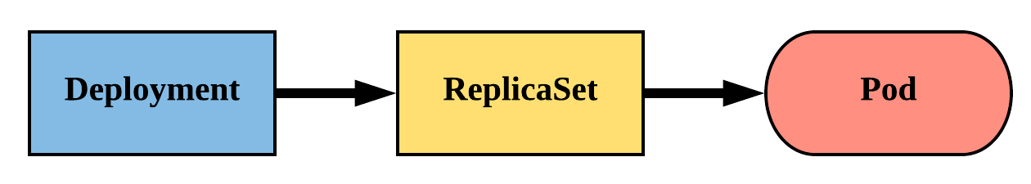
Deployments
Declarative method of managing Pods via ReplicaSets
Provides rollback functionality and update control
Updates are managed through the pod-template-hash label
Each iteration creates a unique label that is assigned to both the ReplicaSet and subsequent Pods

Slide 38
Lab 3 – Deploy Java App on K8 Cluster
Use your Java app image from Docker lab

Slide 39
Lab 4 – Deploy .NET App on K8 Cluster
Use your .NET app image from Docker lab

Slide 40
Lab 5 – Deploy Python App on K8 Cluster
Use your Python app image from Docker lab

Slide 41
Deployments Cont.
revisionHistoryLimit: The number of previous iterations of the Deployment to retain.
strategy: Describes the method of updating the Pods based on the type. Valid options are Recreate or RollingUpdate.
Recreate: All existing Pods are killed before the new ones are created.
RollingUpdate: Cycles through updating the Pods according to the parameters: maxSurge and maxUnavailable.
maxSurge == how many ADDITIONAL replicas we want to spin up while updating
apiVersion: apps/v1
kind: Deployment
metadata:
name: deploy-example
spec:
replicas: 3 revisionHistoryLimit: 3
selector:
matchLabels:
app: nginx env: prod
strategy:
type: RollingUpdate
rollingUpdate:
maxSurge: 1
maxUnavailable: 0
template:
<pod template>

Slide 42
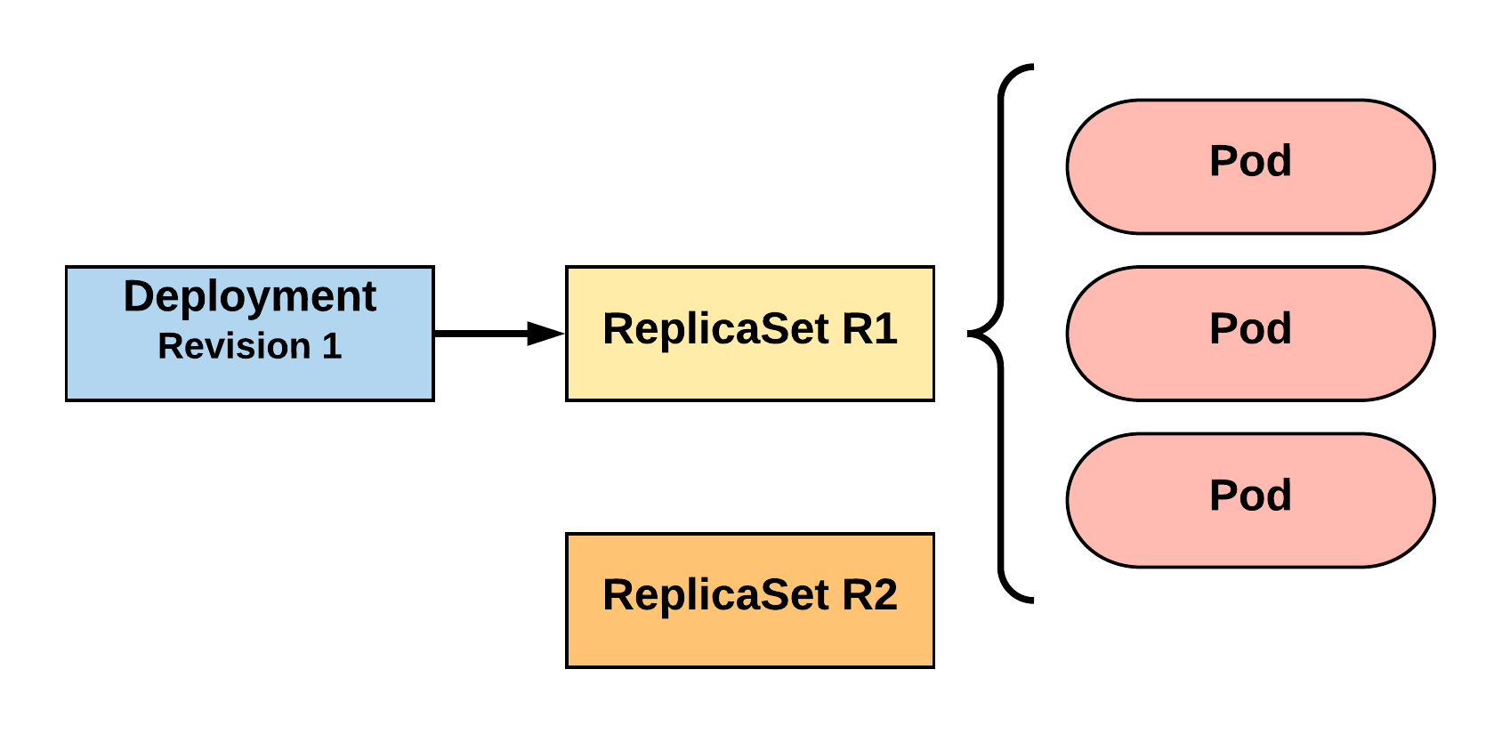
RollingUpdate Deployment
Updating pod template generates a new ReplicaSet revision.
R1 pod-template-hash: 676677fff
R2 pod-template-hash: 54f7ff7d6d
$ kubectl get replicaset
NAME DESIRED CURRENT READY AGE
mydep-6766777fff 3 3 3 5h
$ kubectl get pods
NAME READY STATUS RESTARTS AGE
mydep-6766777fff-9r2zn 1/1 Running 0 5h
mydep-6766777fff-hsfz9 1/1 Running 0 5h
mydep-6766777fff-sjxhf 1/1 Running 0 5h
Notes:
We add a new label, change the image, do something to change the pod template in some way
The deployment controller creates a new replicaset with 0 instances to start

Slide 43
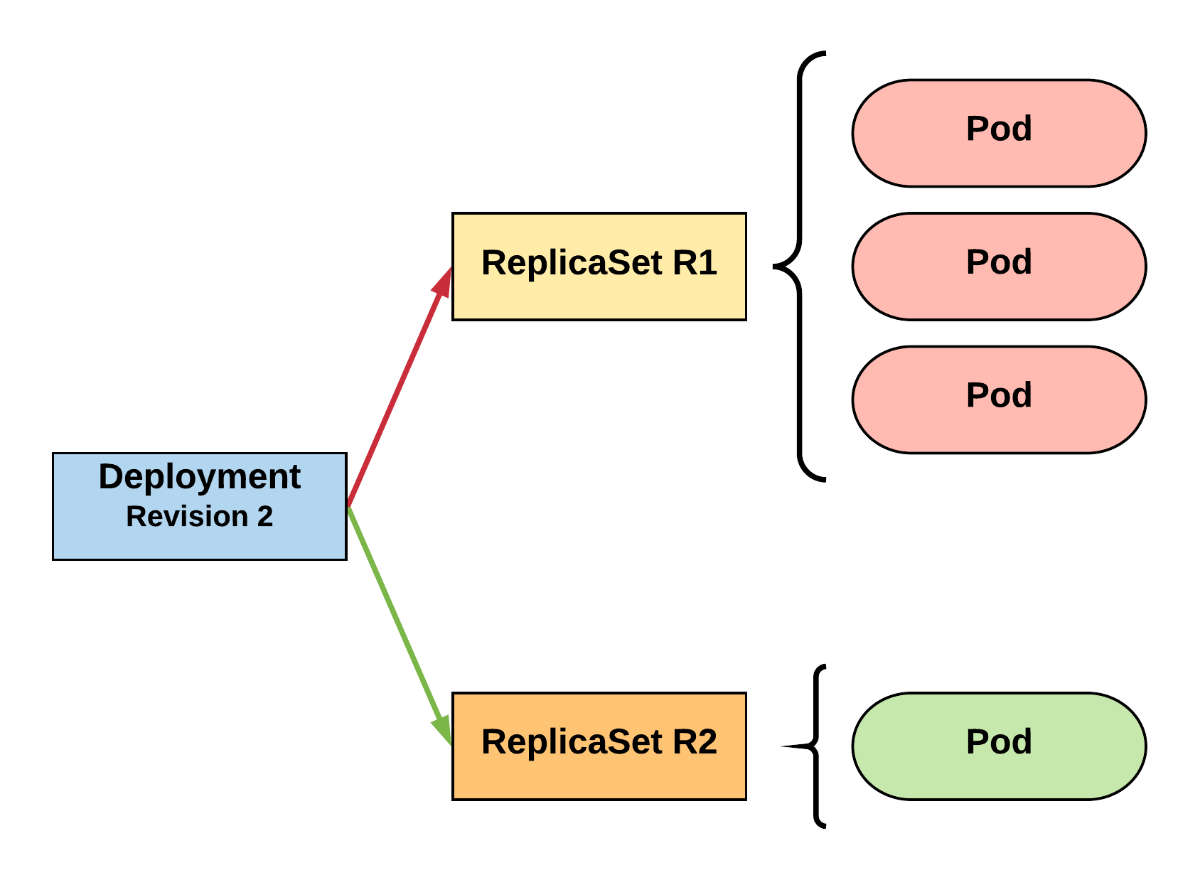
RollingUpdate Deployment
New ReplicaSet is initially scaled up based on maxSurge.
R1 pod-template-hash: 676677fff
R2 pod-template-hash: 54f7ff7d6d
$ kubectl get replicaset
NAME DESIRED CURRENT READY AGE mydep-54f7ff7d6d 1 1 1 5s
mydep-6766777fff 2 3 3 5h
$ kubectl get pods
NAME READY STATUS RESTARTS AGE
mydep-54f7ff7d6d-9gvll 1/1 Running 0 2s
mydep-6766777fff-9r2zn 1/1 Running 0 5h
mydep-6766777fff-hsfz9 1/1 Running 0 5h
mydep-6766777fff-sjxhf 1/1 Running 0 5h
Notes:
It then scales up the new ReplicaSet based on our maxSurge value

Slide 44
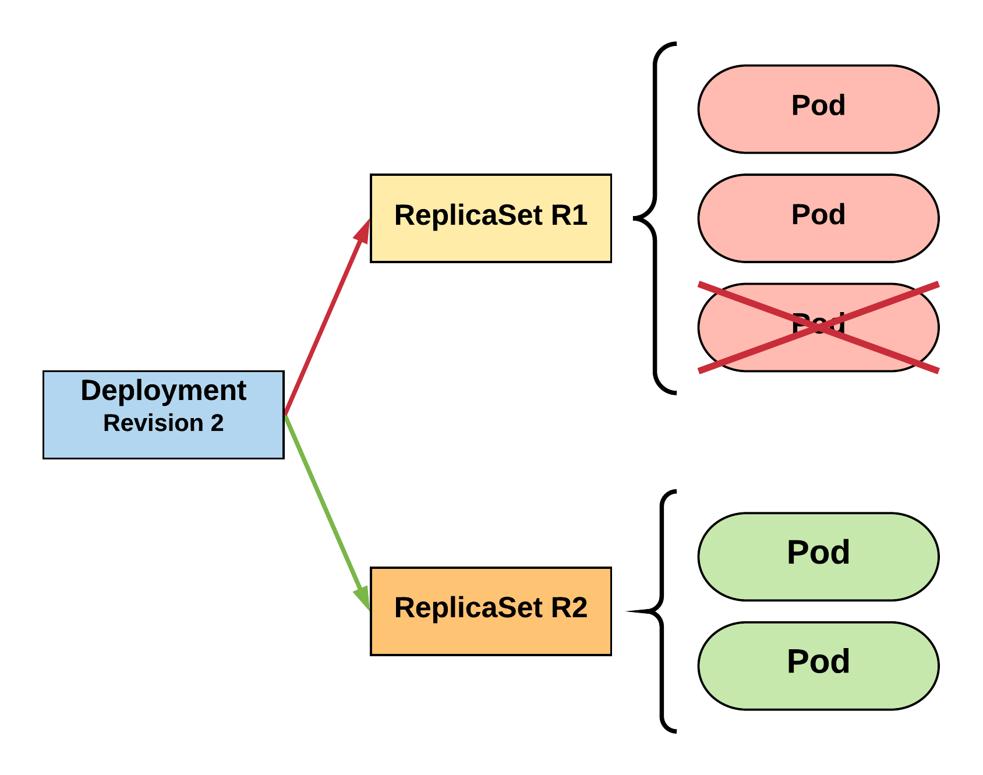
RollingUpdate Deployment
Phase out of old Pods managed by maxSurge and maxUnavailable.
R1 pod-template-hash: 676677fff
R2 pod-template-hash: 54f7ff7d6d
$ kubectl get replicaset
NAME DESIRED CURRENT READY AGE mydep-54f7ff7d6d 2 2 2 8s
mydep-6766777fff 2 2 2 5h
$ kubectl get pods
NAME READY STATUS RESTARTS AGE
mydep-54f7ff7d6d-9gvll 1/1 Running 0 5s
mydep-54f7ff7d6d-cqvlq 1/1 Running 0 2s
mydep-6766777fff-9r2zn 1/1 Running 0 5h
mydep-6766777fff-hsfz9 1/1 Running 0 5h
Notes:
It will then begin to kill off the prevision revision by scaling down the old replicaset and scaling up the new one

Slide 45
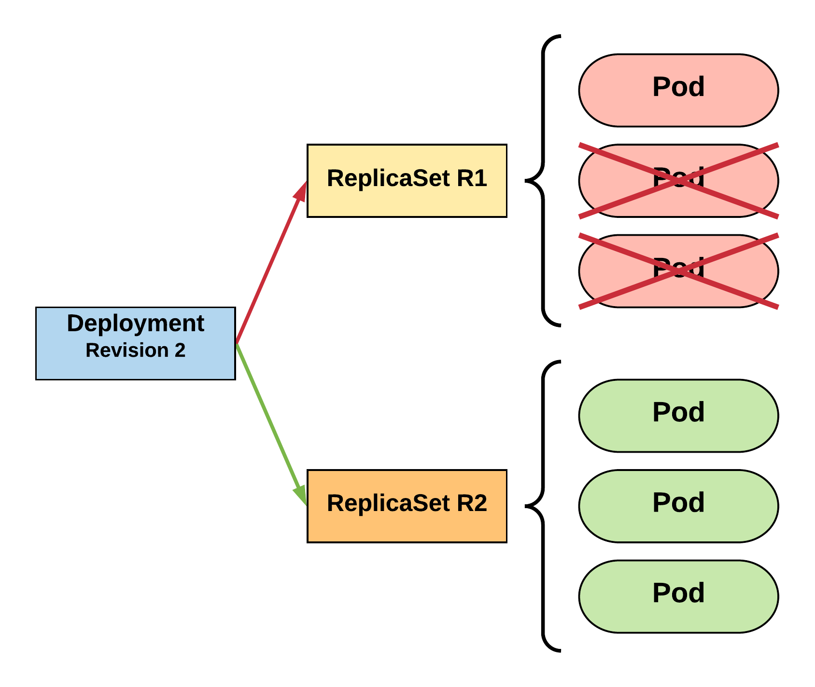
RollingUpdate Deployment
Phase out of old Pods managed by maxSurge and maxUnavailable.
R1 pod-template-hash: 676677fff
R2 pod-template-hash: 54f7ff7d6d
$ kubectl get replicaset
NAME DESIRED CURRENT READY AGE mydep-54f7ff7d6d 3 3 3 10s
mydep-6766777fff 0 1 1 5h
$ kubectl get pods
NAME READY STATUS RESTARTS AGE
mydep-54f7ff7d6d-9gvll 1/1 Running 0 7s
mydep-54f7ff7d6d-cqvlq 1/1 Running 0 5s
mydep-54f7ff7d6d-gccr6 1/1 Running 0 2s
mydep-6766777fff-9r2zn 1/1 Running 0 5h
Notes:
Continues this pattern based on maxSurge and maxUnavailable

Slide 46
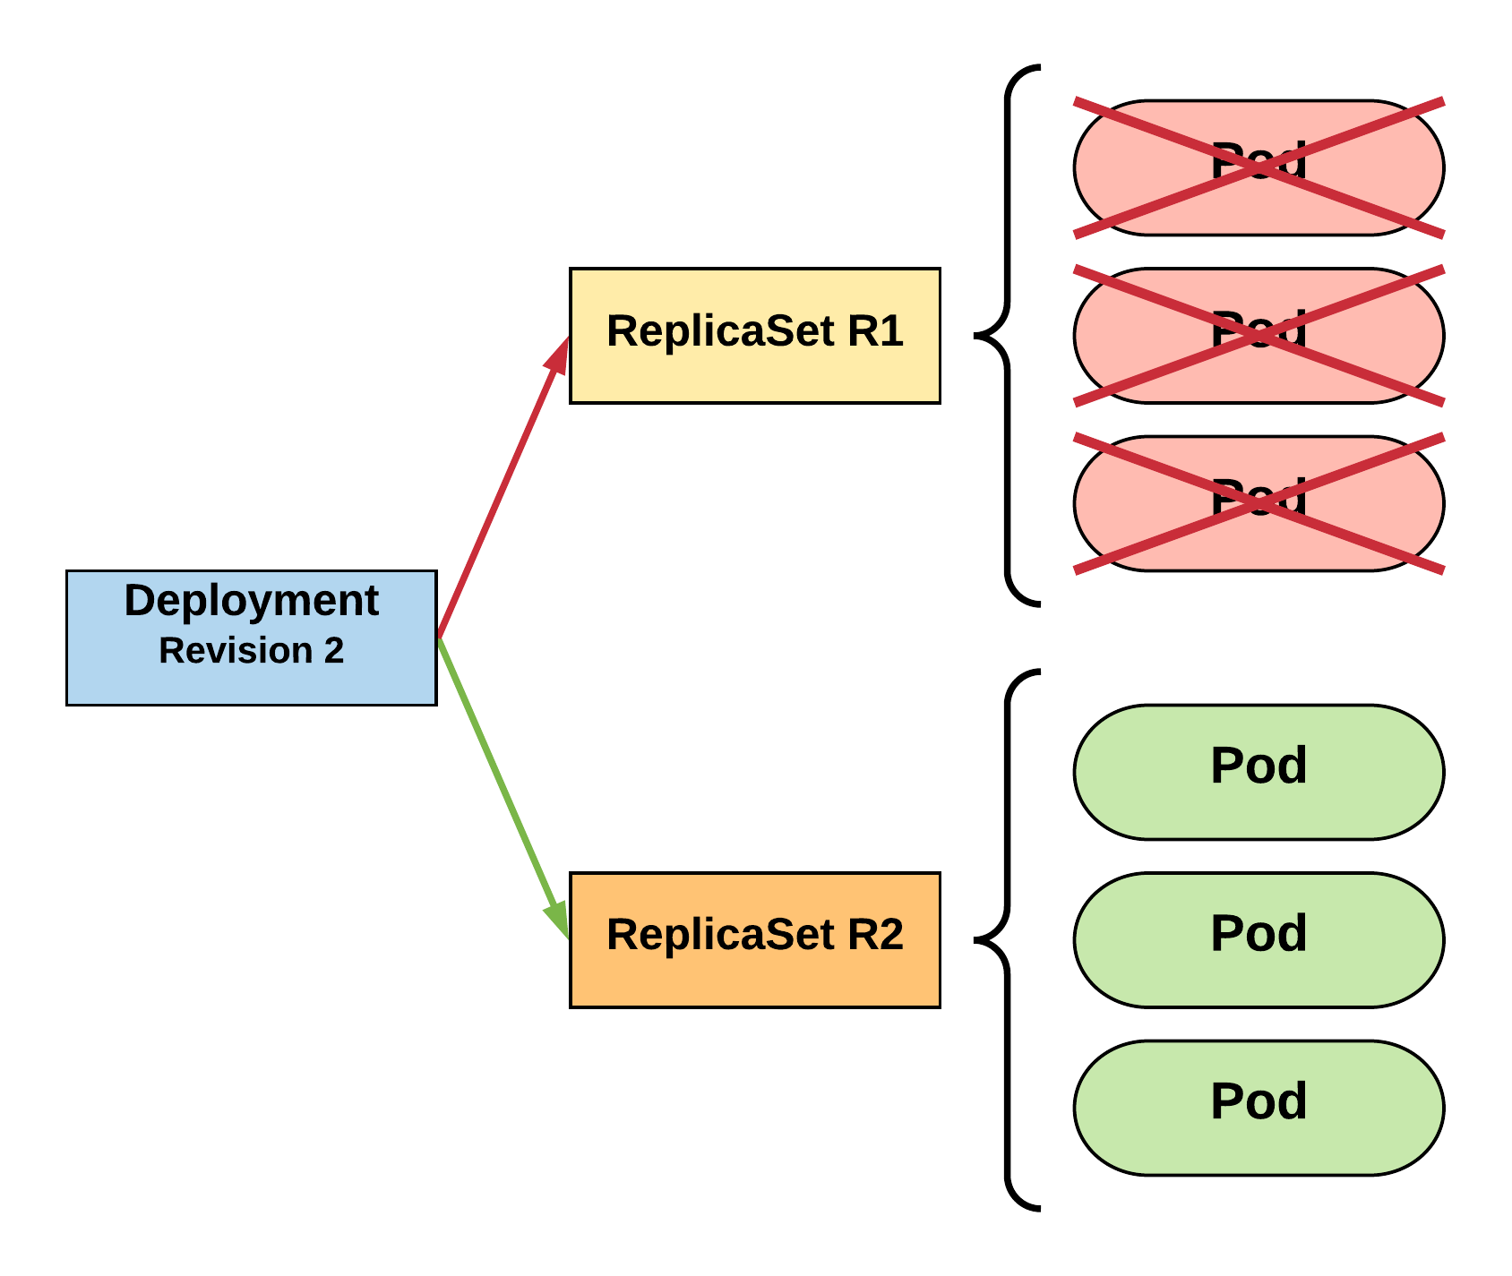
RollingUpdate Deployment
Phase out of old Pods managed by maxSurge and maxUnavailable.
R1 pod-template-hash: 676677fff
R2 pod-template-hash: 54f7ff7d6d
$ kubectl get replicaset
NAME DESIRED CURRENT READY AGE
mydep-54f7ff7d6d 3 3 3 13s mydep-6766777fff 0 0 0 5h
$ kubectl get pods
NAME READY STATUS RESTARTS AGE
mydep-54f7ff7d6d-9gvll 1/1 Running 0 10s
mydep-54f7ff7d6d-cqvlq 1/1 Running 0 8s
mydep-54f7ff7d6d-gccr6 1/1 Running 0 5s
Notes:
Update is complete

Slide 47
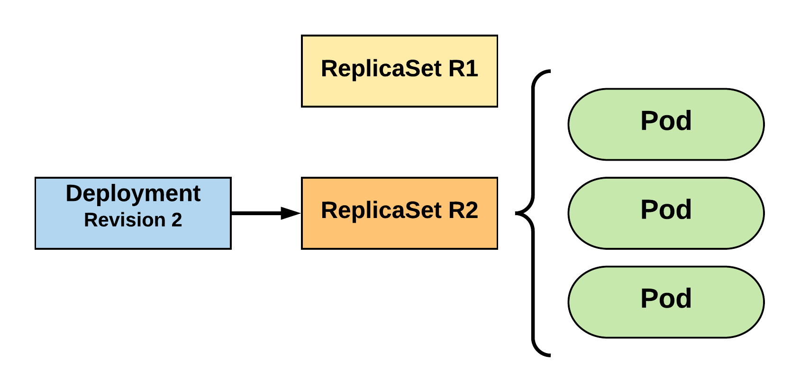
RollingUpdate Deployment
Updated to new deployment revision completed.
R1 pod-template-hash: 676677fff
R2 pod-template-hash: 54f7ff7d6d
$ kubectl get replicaset
NAME DESIRED CURRENT READY AGE mydep-54f7ff7d6d 3 3 3 15s
mydep-6766777fff 0 0 0 5h
$ kubectl get pods
NAME READY STATUS RESTARTS AGE
mydep-54f7ff7d6d-9gvll 1/1 Running 0 12s
mydep-54f7ff7d6d-cqvlq 1/1 Running 0 10s
mydep-54f7ff7d6d-gccr6 1/1 Running 0 7s
Notes:
Until the previous revision is at 0
ReplicaSet will remain around, but it will have 0 replicas. How many stay around are based off our revision history limit

Slide 48
Kubernetes Services

Slide 49
Services
A kubernetes Service is an abstraction which defines a logical set of Pods and a policy by which to access them
Unified method of accessing the exposed workloads of Pods
Durable resource
Uses kube-proxy to provide simple load balancing

Slide 50
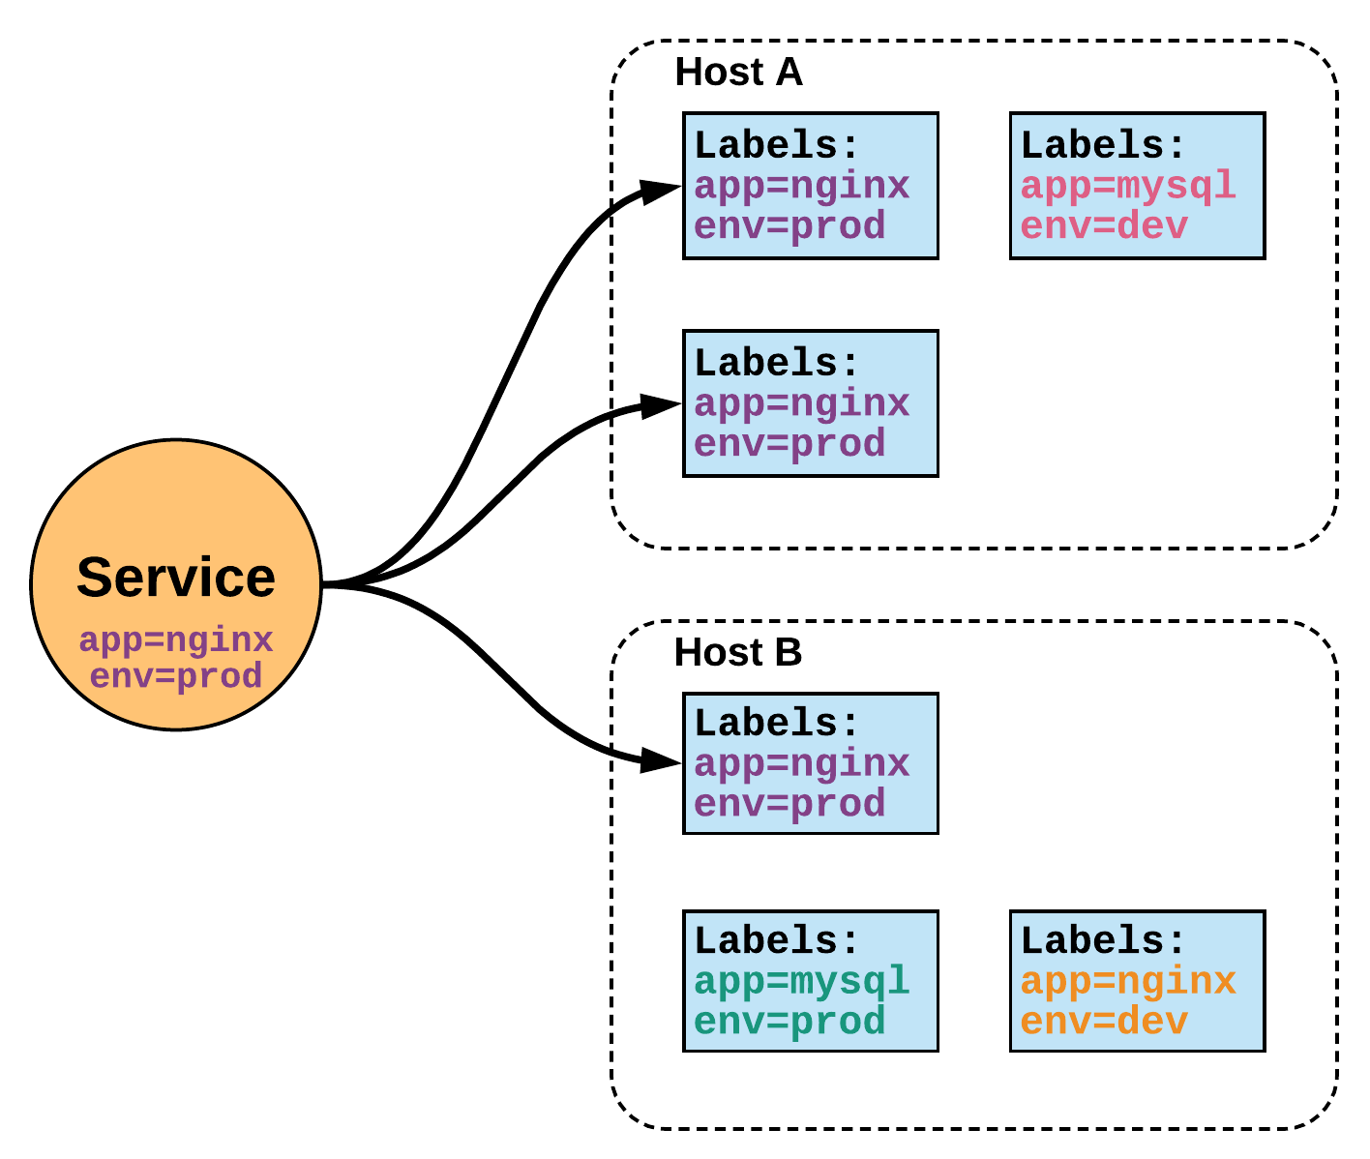
Services (Proxy)
Unified Method of Accessing Exposed Workloads of Pods
Internal Load Balancer to Your Pod(s)
Create a service, reference the pods, for e.g. 3, and (internally) it will load balance across the 3.

Slide 51
Service Types
4 Major Publishing Service Types
ClusterIP (default)
NodePort
LoadBalancer
Ingress

Slide 52
ClusterIP Service
ClusterIP is an internal LB for your application
Exposes a service on a strictly cluster internal virtual IP

Slide 53
NodePort Service
Exposes the service on each Node’s IP at a static port (the NodePort)
NodePort behaves just like ClusterIP, except it also exposes the service on a (random or specified) port on every Node in your cluster.
Port can either be statically defined, or dynamically taken from a range between 30000-32767.
You’ll be able to contact the NodePort service, from outside the cluster, by requesting <NodeIP>:<NodePort>

Slide 54
LoadBalancer Service
Exposes the service externally using a cloud provider’s load balancer
NodePort and ClusterIP services, to which the external load balancer will route, are automatically created.

Slide 55
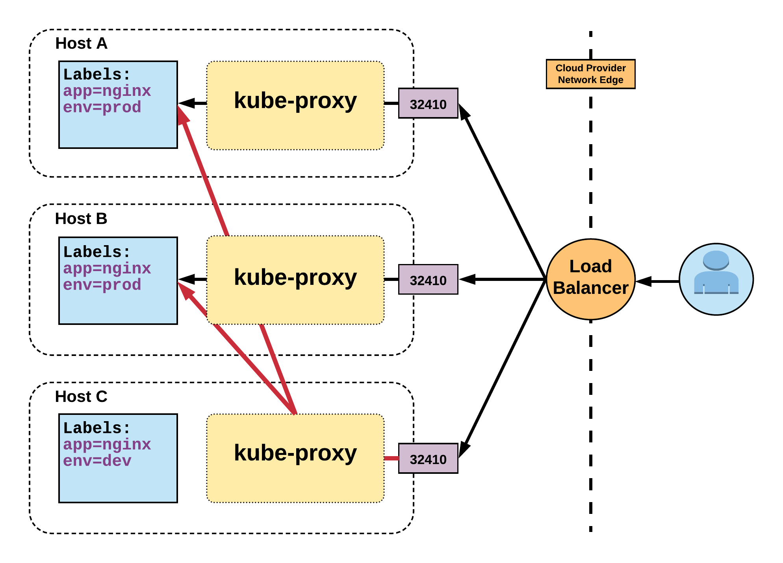
LoadBalancer Service Cont.
Name: example-prod
Selector: app=nginx,env=prod
Type: LoadBalancer
IP: 10.96.28.176
LoadBalancer Ingress: 172.17.18.43
Port: <unset> 80/TCP
TargetPort: 80/TCP
NodePort: <unset> 32410/TCP
Endpoints: 10.255.16.3:80, 10.255.16.4:80

Slide 56
ExternalName Service
Maps the service to the contents of the externalName field (e.g. app1.prod.example.com)
ExternalName is used to reference endpoints OUTSIDE the cluster.
Creates an internal CNAME DNS entry that aliases another.

Slide 57
Ingress
An API object that manages external access to the services in a cluster, typically HTTP
Traffic routing is controlled by rules defined on the ingress resource
An ingress does not expose arbitrary ports or protocols
In order for the ingress resource to work, the cluster must have an ingress controller running

Slide 58
Lab 6 – Run Apps Using Ingress
Create 3 deployments (could be 3 microservices)
Expose these deployments over NodePort
Deploy ingress resource (ingress controller)
Access 3 deployments through this ingress resource
Delete all 4 deployments
Delete all 4 services

Slide 59
Storage Options

Slide 60
Storage
Many workloads require exchanging data between containers, or persisting some form of data
4 types of storage
Volumes
Persistent Volumes
Persistent Volume Claims
Storage Classes

Slide 61
Persistent Volume
A PersistentVolume (PV) represents a storage resource
PVs are a cluster wide resource linked to a backing storage provider: NFS, GCEPersistentDisk, RBD etc.
Generally provisioned by an administrator
Their lifecycle is handled independently from a pod
CANNOT be attached to a Pod directly. Relies on a PersistentVolumeClaim

Slide 62
Persistent Volume Cont.
You define the capacity, whether you want a filesystem or a block device, and the access mode
RWO - only a single pod will be able to (through a PVC) mount this.
ROM - many pods can mount this, but none can write.
RWM - many pods can mount and write.
apiVersion: v1
kind: PersistentVolume
metadata:
name: nfsserver
spec:
capacity:
storage: 50Gi
volumeMode: Filesystem
accessModes:
- ReadWriteOnce
- ReadWriteMany
persistentVolumeReclaimPolicy: Delete
storageClassName: slow mountOptions:
- hard
- nfsvers=4.1
nfs:
path: /exports
server: 172.22.0.42

Slide 63
Persistent Volume Claims
A PersistentVolumeClaim (PVC) is a namespace request for storage.
Satisfies a set of requirements instead of mapping to a storage resource directly.
Ensures that an application’s ‘claim’ for storage is portable across numerous backends or providers.
PVCs can be named the same to make things consistent but point to different storage classes

Slide 64
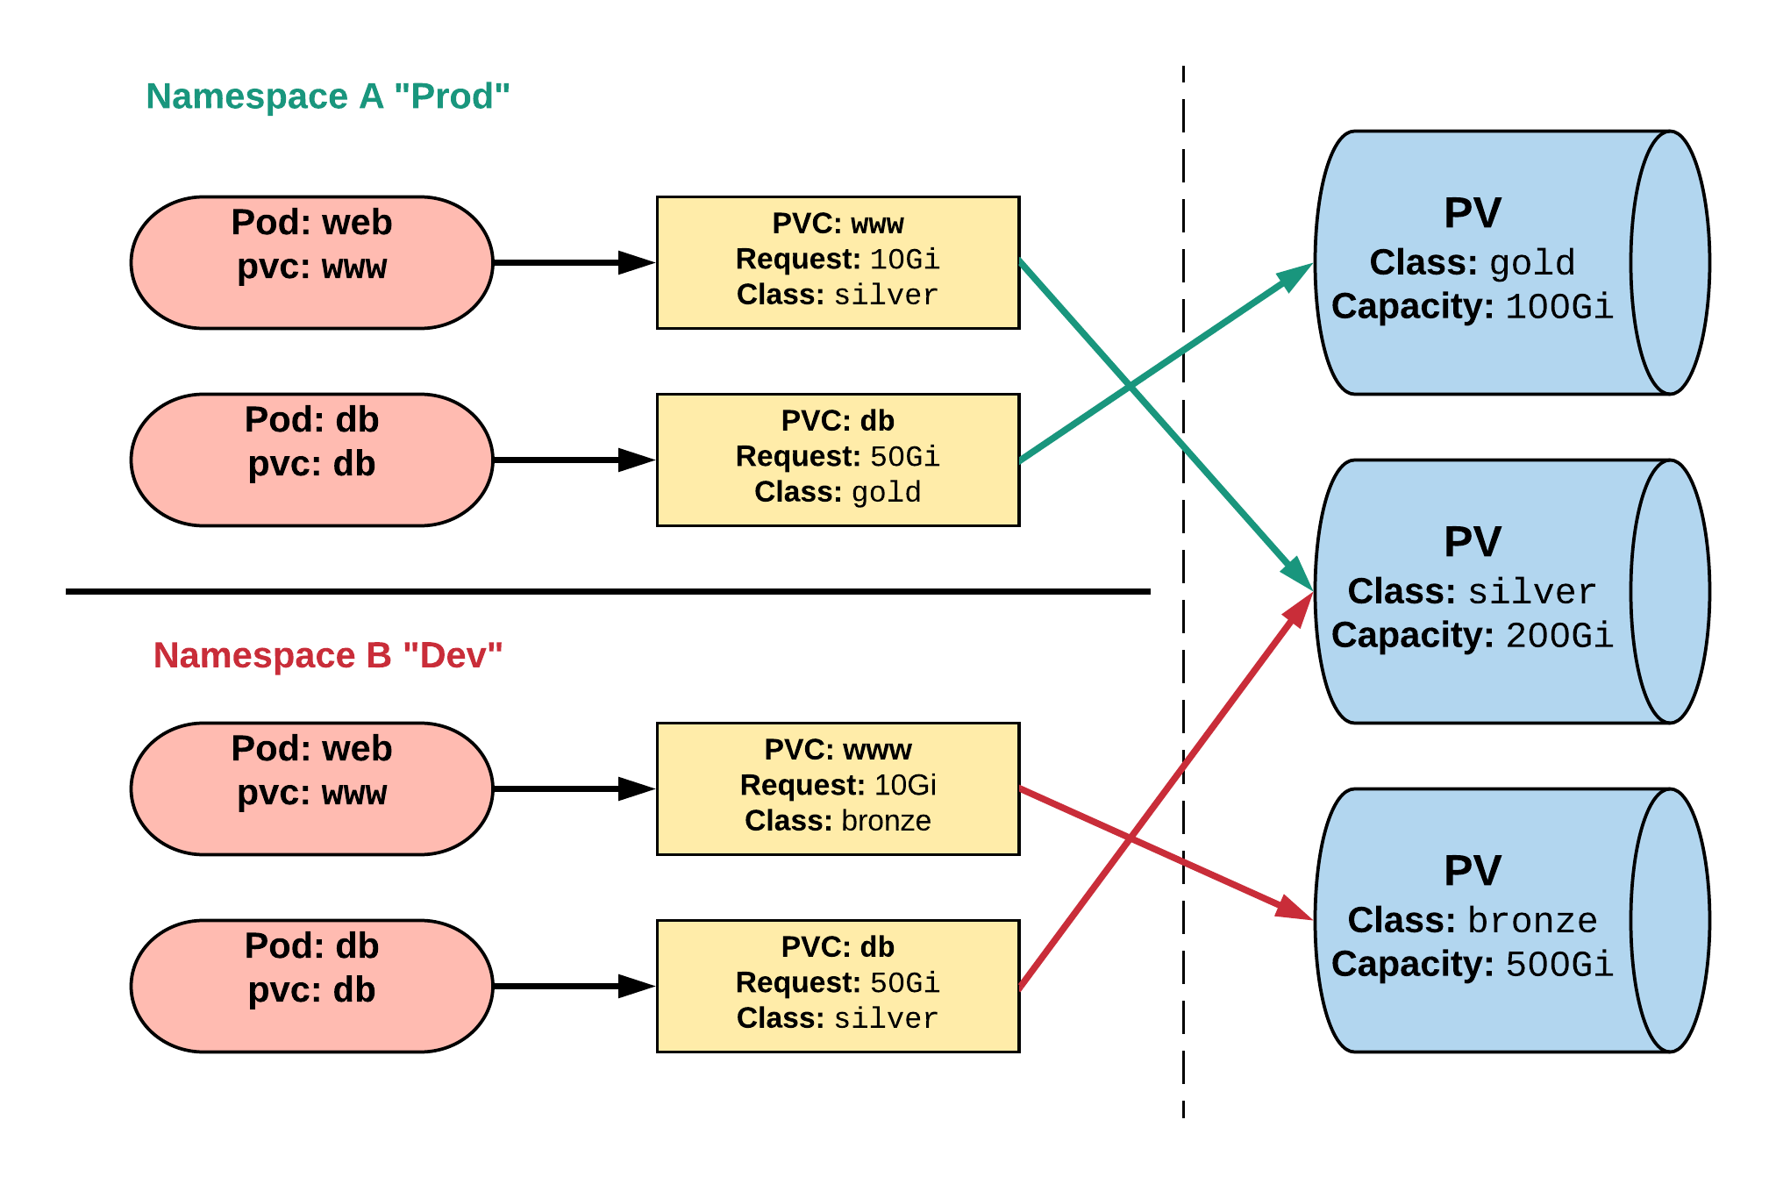
Persistent Volume & Claims
Cluster Users
Cluster Admins

Slide 65
Persistent Volume Phases
Available
PV is ready and available to be consumed.
Bound
The PV has been bound to a claim.
Released
The binding PVC has been deleted, and the PV is pending reclamation.
Failed
An error has been encountered attempting to reclaim the PV.

Slide 66
Lab 7 – Persistent Volumes

Slide 67
Horizontal Pod Autoscaling (HPA)

Slide 68
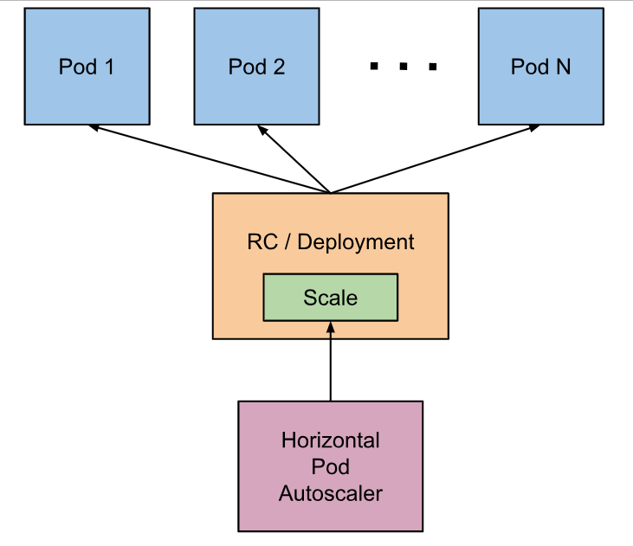
Horizontal Pod Autoscaling (HPA)
The Horizontal Pod Autoscaler automatically scales the number of pods in a replication controller, deployment or replica set based on observed CPU utilization or other metrics
The Horizontal Pod Autoscaler is implemented as a Kubernetes API resource and a controller
https://kubernetes.io/docs/tasks/run-application/horizontal-pod-autoscale/

Slide 69
Lab 8 – Auto Scale Pods
Deploy your app
Add load on your app
Number of Pods will go up, automatically, based on load
Reduce load on your app
Number of Pods will go down, automatically, based on load

Slide 70
Kubernetes Health Checks
Readiness Probe :
Designed to let Kubernetes know when your app is ready to serve traffic
Kubernetes makes sure the readiness probe passes before allowing a service to send traffic to the pod
If a readiness probe starts to fail, Kubernetes stops sending traffic to the pod until it passes
Useful for startup and load management
Transient in nature and tells Kubernetes to route traffic elsewhere

Slide 71
Kubernetes Health Checks
Liveness Probe :
Designed to let Kubernetes know if your app is dead or alive
If you app is alive, then Kubernetes leaves it alone
If your app is dead, Kubernetes removes the Pod and starts a new one to replace it

Slide 72
Lab 9 – K8 Health Checks
Configure Liveness Probe
Configure Readiness Probe

Slide 73
Monitoring Kubernetes

Slide 74
Monitoring Challenges for Kubernetes
Many, smaller pieces to monitor
Keeping track of pods and containers
Health of deployed applications and containers
Availability of resources in a deployment/cluster

Slide 75
Monitoring Kubernetes – Data Sources
K8 Hosts Running Kubelet
K8 Process i.e. Kubelet Metrics : give you details on a Kubernetes node and the jobs it’s running
Metrics for apiserver
kube-scheduler
kube-controller-manager
Kubelet’s Built-in cAdvisor : collects, aggregates, processes, and exports metrics for your running containers
Kube-state Metrics : gives you information at the cluster level

Slide 76
Metrics Server
Cluster-wide aggregator of resource usage data
Metric server collects metrics from the Summary API, exposed by kubelet on each node
5000 nodes clusters with 30 pods per node, supported by kubernetes 1.6
To collect 10 metrics from each pod per node
10 x 5000 x 30 / 60 = 25000 metrics per second by average
This required a new server instead of API service, hence metrics server was created

Slide 77
Lab 10 – Monitor K8
Uses Prometheus & Grafana
Monitor Nodes
Monitor Pods
Monitor Deployments
And Much More

Slide 78
Kubernetes Best Practices
Configure Health Checks
Use Multiple Clusters
Begin with One Container in One Pod
Keep Your Images Small

Slide 79
Path Forward
Start with a managed service
Docker Documentation (Docker.com)
K8 Documentation (Kuberntes.IO)
Automate Image Creation, Storage and Deployment
Create and Use Official Images Repository
Use Docker Swarm for Small Workloads
Start with Stateless Applications

Slide 80
This concludes Chapter 3 Container Orchestration with Kubernetes

